Slide 1







Literature Review
Ch1
Ch2
Ch3
Ch4
Ch5
Ch6
Welcome
Lit. Review
Methodology
Design
Results
Introduction & Conclusions
2nd part of the Guided Research Track (GRT)
RRSG Seminar
Prepared by Dr. Simon Winberg
Drilling
for
knowledge
For ELO discussion later in the session, students are expected to bring along their initial effort on the ELO tracking form.
Notes:
This presentation was prepared for the ‘guided research track’ (GRT) for new grad students

Slide 2
Today’s Agenda
Thoughts on where you should be at in your project timeline
Reviewing the literature and writing the Literature Review chapter
Literature and research software tools
Using a reference manager
Grammar checkers and other online tools
ELO Review
Q&A / further discussion
2 mins
15 mins
3 mins
20 mins
5 mins

Slide 3
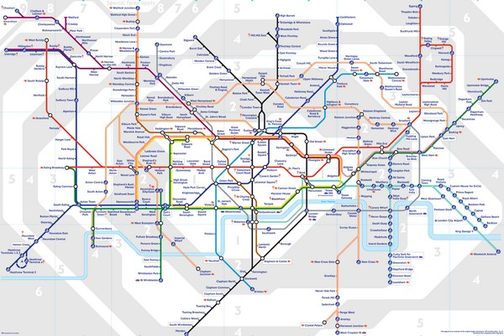

Where should you be?
In terms of project progress?
?
?
?

Slide 4

BSc Project Roadmap
START
CHOOSE PROJECT & REFINE SPECS
IN-DEPTH UNDERSTAND OF PROJECT
CLEAR PLAN OF ACTION
STARTED LIT .
REVIEW
DECIDE COMPONENTS, TOOLS
START DEV .
& DESIGN WORK
WRITE UP METHODOLOGY, DRAFT DESIGN
INITIAL TESTS
REFINEMENTS
MAIN EXPERIMENTS
REFINE LIT. REVIEW
FOCUS ON WRITE-UP
PREP ORAL PRESENTATION, OPEN DAY POSTER, ETC.
SUBMIT

Slide 5


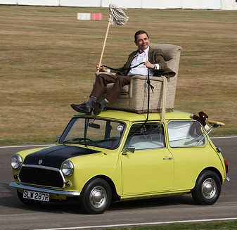
So… are you
On track
Suddenly realized you’re going the wrong way
Blissfully unaware of where you may be

Slide 6
Literature Review
Advice

Slide 7
What is a literature review?
A Literature Review:
Surveys, summarizes & links to related research (i.e. existing literature) for a research-based task.
Note: a Literature Review is NOT an ‘annotated bibliography’. An annotated bibliography comprises:
Bibliographic information for the source.
Authority and/or qualifications of the author
Scope / purpose of the work
Identifying detectable bias or interpretive stance
A summary
Source: http://en.wikipedia.org/wiki/Annotated_bibliography

Slide 8
Why a Literature Review?
A Literature Reviews is needed to provide the following:
Indication that you know WHAT is out there
Helps to show that you have gained a sufficient depth of knowledge in the field/topic concerned;
Provides an indication of how your research is situated within the broader field(s) that your project relates to.
How long should it be?
Most NB

Slide 9
Main purpose of the lit review
Defining terms / Describing theories
Justification for decisions made
Most NB
What you are building on
View of alternate approaches / related work
Drilling
for
knowledge

Slide 10
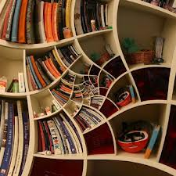



How to organize the literature review
By Theme (typical of engineering & science)
Separating out the information into different aspects (i.e., compartmentalizing)
And synthesizing: brining together the (possibly different) views and insights into something used in the project; often indicating how/where this is used in the study.
By Author (more common in social sciences)
Process of discussing (usually at length), and one at a time, contributions made by a particular author or team
Bringing together and summarizing the various viewpoints into a summary or ‘agreed viewpoint’; often indicating how this is to be used in the study concerned.

Slide 11

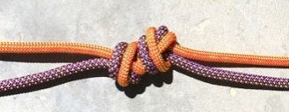
Length of the literature review
Around 20 to 30% of the manuscript (excluding pages of appendices) – if it is a design project rather than a literature study (‘meta-study’)
Long literature reviews (50+ pages)
Done for PhD theses, sometimes dissertations, technical books and similar texts.
These will likely cite and discuss many different studies and opinions for a specific issue.
Short literature reviews (<50 pages)
Smaller BSc level studies, sometimes also appropriate for MSc or MEng level of study.
Likely cites only one or two references for each issue (instead of constructing a long argument motivating a particular viewpoint followed in the research project)

Slide 12
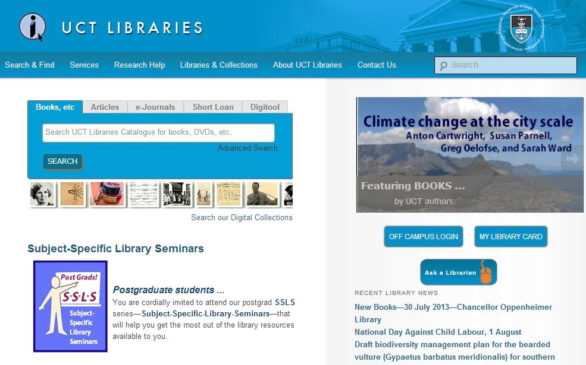
Techniques & Tools
Should have a good range of peer review journal papers and conference papers
Don’t just use webpages, forums, tutorials and datasheets (of course some of these would be expected as well considering you will probably be doing some development)
Tools:
Google Scholar
UCT Library e-journals databases
UCT eproxy access to access electronic journals off campus
http://www.lib.uct.ac.za/

Slide 13
Techniques & Tools
Reference managers
A tool to keep track of references, sources, maybe copies of the doc (e.g. pdfs) and can usually generate citations according to a specific referencing style
Suggested reference manager tools:
Mendeley http://www.mendeley.com/
Very useful; this is one I use. Online features; ‘cloud service’ - keep your reference lists online and accessible from anywhere. Share references and collections with other Mendeley users. Word plugin. Can generate bibtex.
JabRef http://jabref.sourceforge.net/
Java application. Useful especially for Latex users for managing bibtex databases. Also useful if using MS Word.
RefWorks: available from UCT library website
UCT library has some useful information about referencing see: http://www.lib.uct.ac.za/research-help/referencing-help

Slide 14
Techniques & Tools: Spreadsheet Knowledge Base
Use of a spreadsheet to build a “knowledge base” to keep track of useful points, insights and abstracts or snippets of information obtained from particular sources
Lit Review - knowledge base
Key Points | Authors | Date | Title / Citation | Notes / interesting quotes and facts obtained | Abstract / relevant snippets from abstract/paper
Sensor networks; Networking unattended sensor; Classification of protocols | Kemal Akkaya, Mohamed Younis | 2005 | A survey on routing protocols for wireless sensor networks | "The decrease in the size and cost of sensors, resulting from such technological advances, has fueled interest in the possible use of large set of disposable unattended sensors." "Networking unattended sensor nodes are expected to have significant impact" | ... Most of the attention, however, has been given to the routing protocols since they might differ depending on the application and network architecture. This paper surveys recent routing protocols for sensor networks and presents a classification for the various approaches pursued... The three main categories explored in this paper are data-centric, hierarchical and location-based. ... Moreover, protocols using contemporary methodologies such as network flow and quality of service modeling are also discussed. The paper concludes with open research issues.
knowledge base = a store of information/data that is available to draw on, used in solving problems, making decisions, etc.

Slide 15
Other useful tools
Grammar checkers
MS Word has an excellent grammar checker and spell checker; but if you’re using OpenOffice or Latex you might want to find another tool to assist with this (especially if you aren’t English 1st lang).
Some suggestions:
http://www.grammarly.com/
http://www.paperrater.com/
http://www.gingersoftware.com/products/grammar-check
Please use caution when trying out the grammar checking tools that you have to download or need to register for; some of them may end up sending you spam email. Also consider working as a team to find good tools.

Slide 16
Plagiarism checkers (?)
I’m of the opinion that you shouldn’t need to use Plagiarism checkers.
If you are indeed using all your own words (and perhaps a few referenced quotes) then this shouldn’t be any concern.
Be cautious of putting things in TurnItIn – I know you can get access to this in various ways but if you use the wrong settings when uploading your manuscript to check it, you may end up causing problems later.
There are some situations (e.g. follow-up projects) where there might be parts that have some similarity to the earlier work. In such a case you should indicate in the intro that it is a follow-up (e.g. carrying out future work plans recommended by a past student) and reference things appropriately.

Slide 17

Now over to you…

Slide 18
Now over to you…
Peer Review of ELOs
Suggested order of doing the ELOS:
Take a few minutes to discuss your ELO forms with your neighbor
The idea is to have concisely worded and clear responses to the actions
ELO3*
ELO4*
ELO6
ELO8
ELO9
The supervisors and postgrads will come round to have a look and provide comments on what you’ve done / planning to add.
* Probably can only Finish ELO3 and 4 later After the main design phase is done

Slide 19
Finalizing Session 2
…

Slide 20

A preview of the next episode of GRT …
“What’s expected for the Methodology & Design…”
Q: What is Research?
A:
Discovering new things …. ?
to go where no one has gone before?
… Maybe so. Actually it depends at what level your working at (e.g. personal development or societal etc.)
A BSc project doesn’t have to be unique, but it needs to be your own work.
Discovering new things
Ideally “to go where no one has gone before” – but that’s usually only in the area of PhD.

Slide 21

Ch1
Ch2
Ch3
Ch4
Ch5
Ch6
Welcome
Lit. Review
Methodology
Design
Results
Introduction & Conclusions
next session
Questions?

